Slide 1
histograms: explain how to think about a 3D color histogram

Slide 2
Slides: clarity of expression
Slides: quality of examples/diagrams/figures
Presentation: correctness
Presentation: clarity of the explanation
Presentation: quality of examples chosen for the purpose of teaching
Presentation: you introduce yourself and your topic
Presentation: make good use of your time and stay within the specified time limit
Presentation: the presentation aligns with and doesn't overlap significantly with related topics
Submission: includes a link to your video, a pdf of your slides, and a readme with your name, a reflection, and acknowledgement that includes how (if) you used an LLM

Slide 3

Color Histograms Primer
Groups continuous data into discrete bins
Visualizes what colors are dominant in an image
:

Slide 4

RGB Color Histograms
Three options:
Three 1D Histograms
Captures intensity and color ratio (chromaticity)
Does not capture spatial correlation
2D Chromaticity Histogram
Captures color ratio and spatial correlation
Does not capture intensity
3D “Cube” Histogram

Slide 5
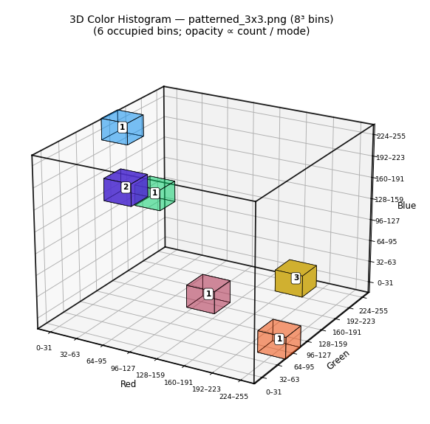
3D “Cube Histogram”
Captures intensity, color ratio AND spatial correlation
More bins = more color resolution
Less bins = less computational effort
Biology argument: Human visual system separates brightness and color, reasonable to assume this is a good thing

Slide 6

Example

Slide 7
Why 3D Histograms? Biology Note
The Human visual system

Slide 8
Earth Movers Distance (1D): (3D):
Histogram Intersection (1D): (3D):

Slide 9
Features

